Slide 1
Creating a Database Using
SQL Express
We are using 2017.
The presenter here is using 2012 so some things will look slightly different, but the functions are all the same.

Slide 2

Creating a
SQL Server 2012 Database
Using Management Studio

Slide 3
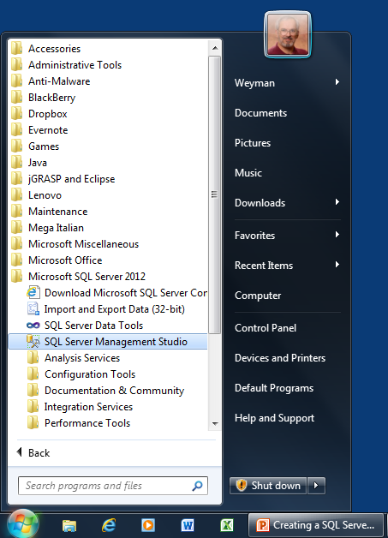
SQL Server Management Studio
Menu Item
SQL Server Management Studio may be used to create SQL Server databases.
The Windows menu item used to run this program is in the Microsoft SQL Server 2012 folder.

Slide 4
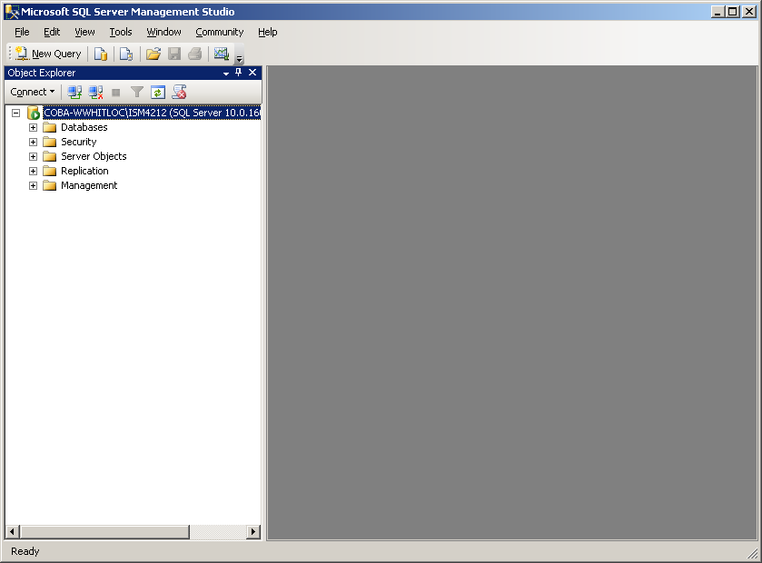
Management Studio Screen
When Management Studio starts, the screen will appear similar to this.
Note: Your screen will look slightly different from this, based on the name of your PC and the name of the Windows account that you use.
NOTE: From this slide on, the screen shots actually show SQL Server 2008 in use. However, the usage of SQL Server 2012 is the same as that shown here.

Slide 5
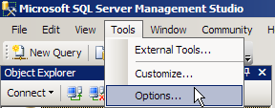
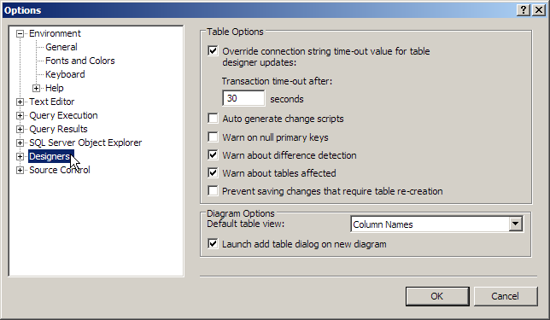
Options Settings
Before beginning work in Management Studio, you should verify one of the Options settings.
Click Tools in the menu bar. From the drop-down menu, select the Options item.
In the Options dialog box, click the Designers category in the area on the left-hand side of the dialog box. Then, on the right, make sure that the box labeled “Prevent saving changes that require table re-creation” is UNchecked (as shown here).
(This may already be the case.)
Click the OK button when done.

Slide 6
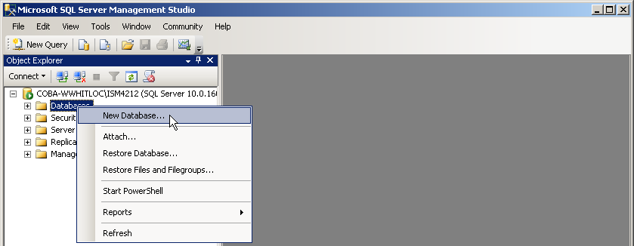
Creating a New Database
To create a new database, right-click on the Databases object name in the Object Explorer pane on the left side of the screen, and then click on the New Database command.

Slide 7
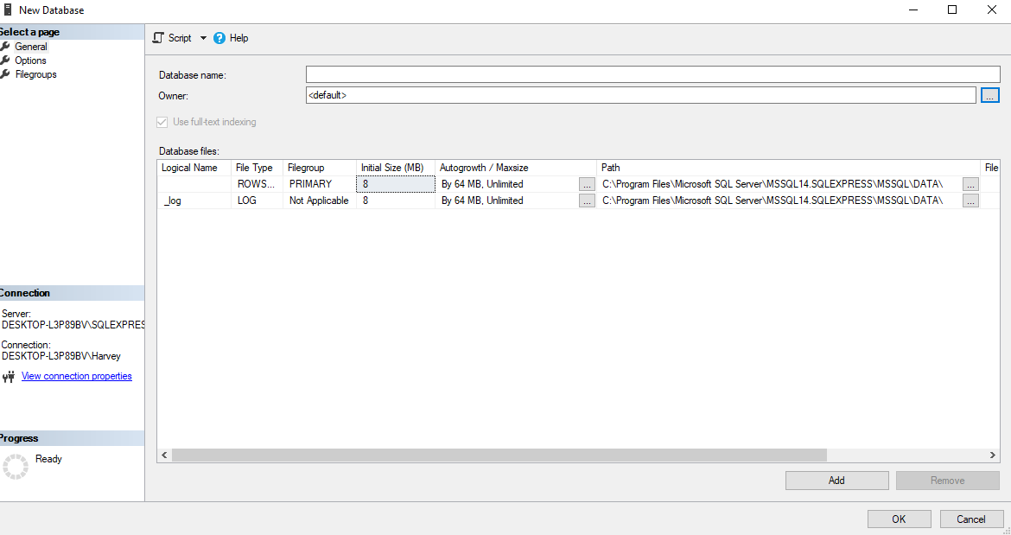
New Database Dialog Box
The New Database dialog box appears.
Use the default path already set by SQL Server.

Slide 8
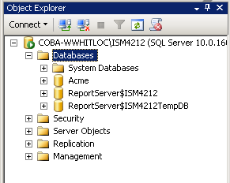
New Database
The newly defined database is added to the Database category in the Object Explorer pane.
To see the new database
object, click on the + sign
icon to the left of the Data-
bases category to open
a listing of the names of
the databases attached to
the current instance of
SQL Server.

Slide 9
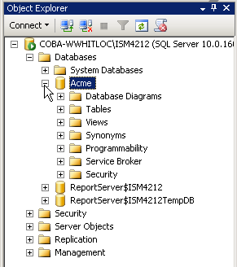
Database Objects
To see the categories of
objects that make up the
new database, click on
the + sign icon to the left
of the name of the data-
base to open a list.
Our first task in working
with this new database
will be to add some
tables to hold data.
(See following slides.)

Slide 10
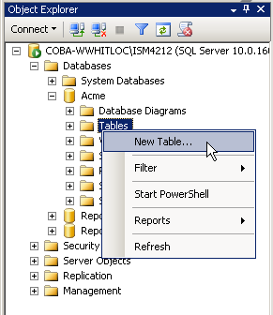
Creating a New Table
To create a new table,
right-click on the Tables
object name in the list
of objects for the Acme
database.
From the pop-up menu,
click on the New Table
command.

Slide 11
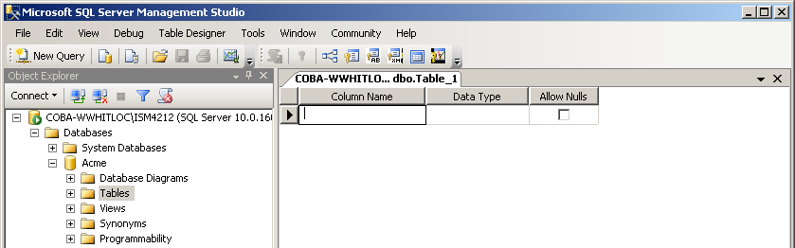
Table Designer
The Table Designer pane opens to the right of the Object Explorer pane. In this pane, you will specify the name and data type of each desired column in the table, as well as specify whether each column can contain null values.

Slide 12
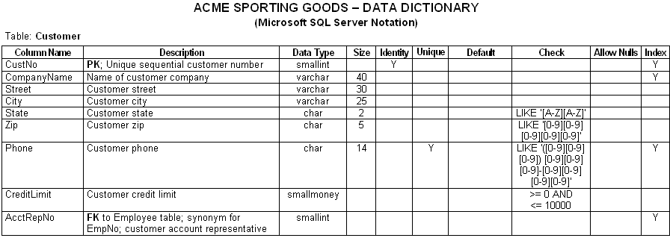
Data Dictionary
It is helpful, in creating tables for a database, to have previously constructed a data dictionary containing the column definitions of the tables. This serves as a “blueprint” for the database.
(The following slides will create the table shown below.)

Slide 13
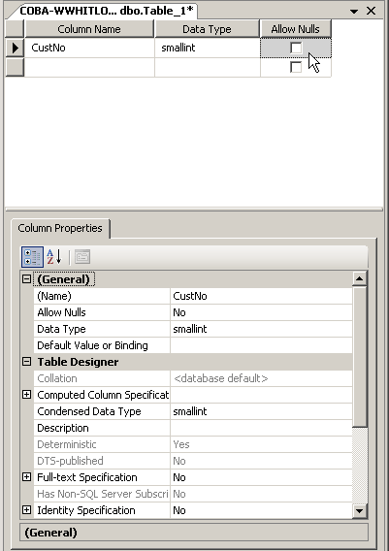
Creating the Customer Table
Here, the Table Designer
pane is shown as the first
table column (CustNo) is
being defined.
The Column Properties
area at the bottom of the
pane lists properties for
which values can be set,
including the Default
and Identity properties
(described on later slides).

Slide 14
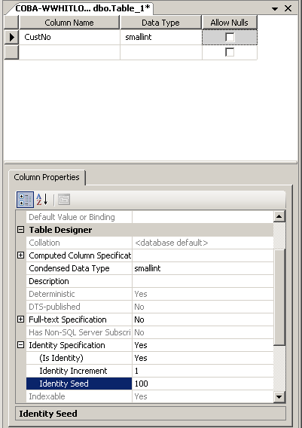
Setting a Column Identity Property
In the Data Dictionary,
the CustNo column has
the Identity property set
to Yes. This is applied in
the Column Properties
area, as shown here.
Note: The Identity Seed property shows the value that will automatically be entered for this column in the first row of the table.
(Set this value to 100 for this example.)
The Identity Increment property shows the increment that will be added to the column value for each succeeding row of the table. (Leave this value set to 1 for this example.)

Slide 15
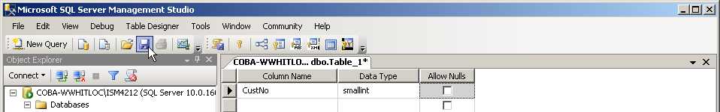
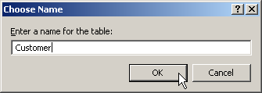
Saving and Naming a Table
Periodically save your table design work by clicking the Save button in the Tool Bar.
The first time that you save a table’s design, you will be prompted to provide a table name. Type in the desired name, then click OK.

Slide 16
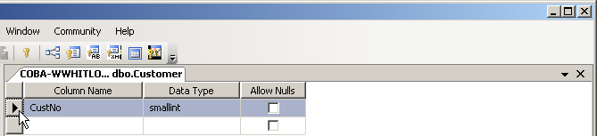

Specifying a Primary Key
To set a column as the PK of a table, click to the left of the column name to select the row.
Then, click the Primary Key button in the Tool Bar. A small key icon will appear to the left of the column name, indicating PK status.
NOTE: If the desired PK is a CPK, hold down the Ctrl key while clicking to the left of each of the columns to include.

Slide 17
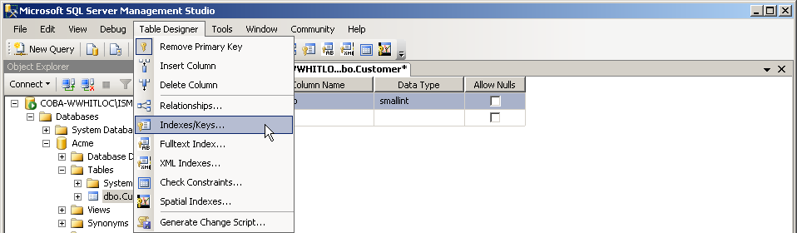
Primary Key Index
Specifying a column (or columns) as a table PK (or CPK) automatically creates an index on the column(s) in the table. This can be seen by clicking the Table Designer menu item in the Menu Bar, then clicking Indexes/Keys in the drop-down menu (see next slide).

Slide 18
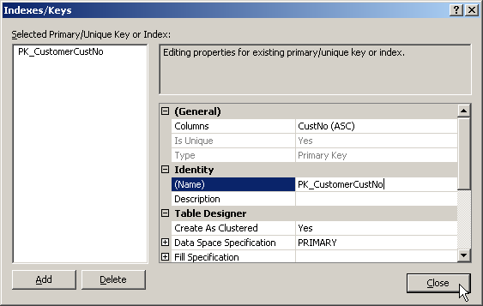
Editing the PK Index Name
The Indexes/Keys dialog box appears with the PK index created. (Note the Type property setting.) Recommended: append the PK column name to the Name property value, as shown here.
A good naming convention to follow for Primary Key indexes is:
* Prefix of PK, followed by
* Underscore, followed by
* Table Name, followed by
* PK Column Name
In the case of a CPK, include each CPK column name in the name of the Primary Key index.
Click Close to continue.

Slide 19
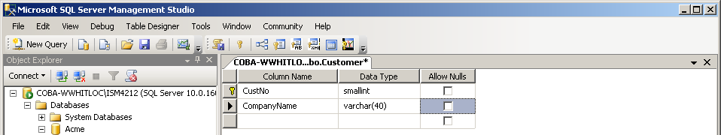
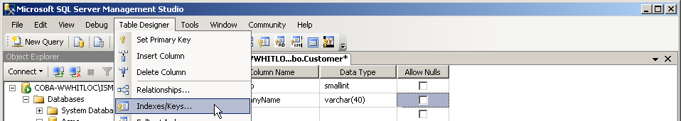
Creating a Regular Index
Here, the second column has been added to the table. According to the Data Dictionary, an index needs to be created for this column.
Again, the Indexes/Keys command is selected.

Slide 20
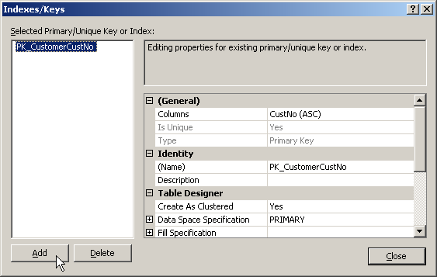
Creating a Regular Index
The Indexes/Keys dialog box appears. The name of the index created earlier for the PK column appears in the white box on the left. Click the Add button to add a new index.

Slide 21
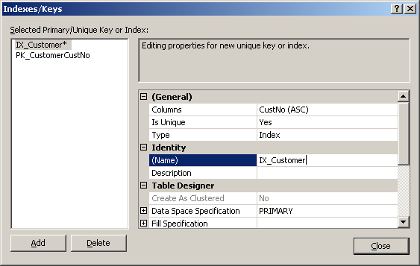
Creating a Regular Index
A new index name has now been added to the white box on the left. As before, this name should be customized to include the name of the column being indexed (CompanyName, here).
Edit index name here.
(Result shown
on next slide.)

Slide 22
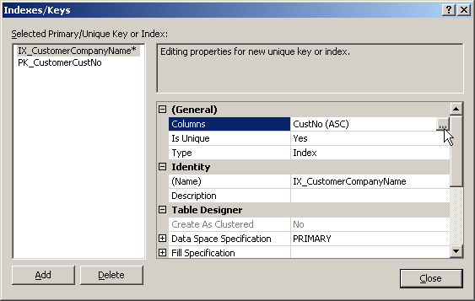
Creating a Regular Index
After editing the index name, specify the col-umn to index. (Editing the index name does not do this.) Click in the Columns row, then click the button labeled with 3 periods that appears.

Slide 23
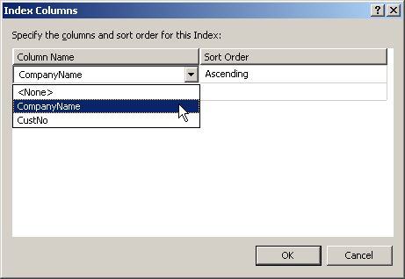
Creating a Regular Index
The Index Columns dialog box appears. Click the arrow for the combo box on the left side of the screen to drop down a list of available columns to index. (Choose CompanyName, here.) (Leave the Sort Order setting as it is for this index.)
Click OK to continue.

Slide 24
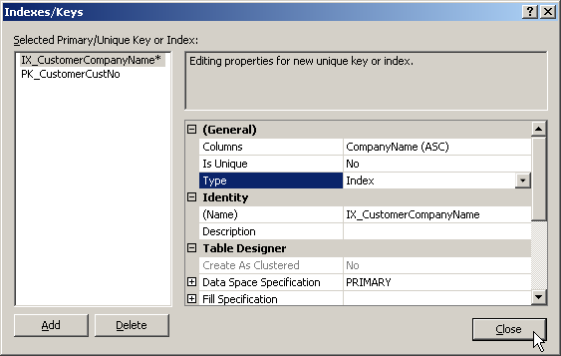
Creating a Regular Index
Make sure that the Is Unique and Type proper-ties are left with their default settings as shown below, then click the Close button. This com- pletes the creation of this index.

Slide 25
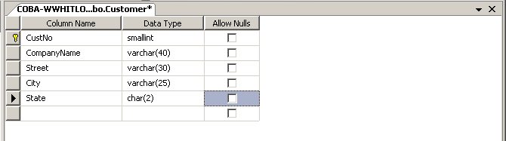
Adding Additional Table Columns
Continue to follow the Data Dictionary definition of this table by adding the Street, City, and State columns as shown below.
Note in the Dictionary that the State column has a Check constraint set for it. We will create this constraint on the following slides.

Slide 26
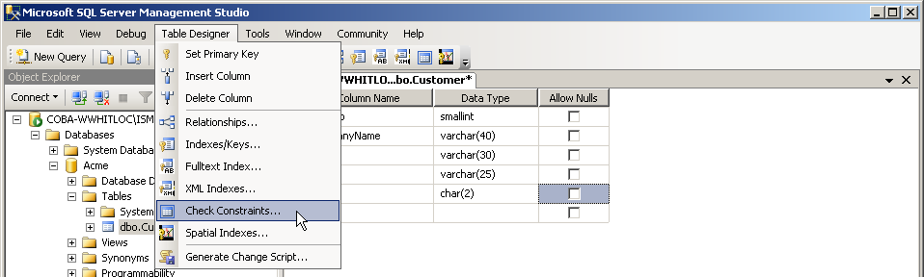
Creating a Check Constraint
To create a Check constraint, click on the Table Designer item in the Menu Bar, and then select the Check Constraints item from the drop-down menu, as shown below.

Slide 27
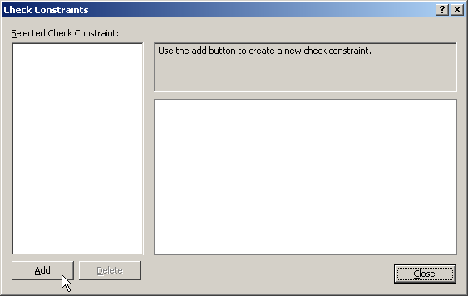
Creating a Check Constraint
The Check Constraints dialog box appears. Because we have not yet created any Check constraints for this table, the box is empty. Click the Add button to begin.

Slide 28
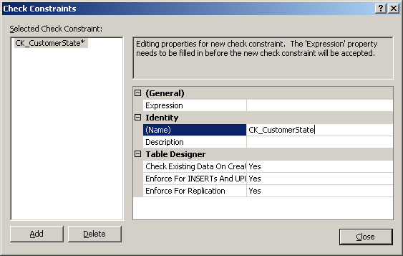
Creating a Check Constraint
A new constraint name has now been added to the white box on the left. As before, this name should be customized to include the name of the column being constrained (State, here).
Edit constraint name.

Slide 29
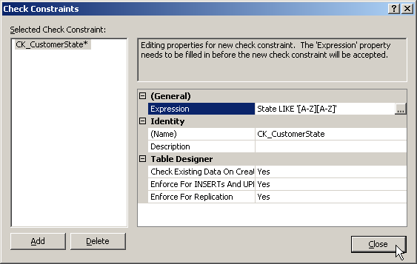
Creating a Check Constraint
Now, the actual expression must be written that will enforce the desired constraint on the data to be entered into this column. (In this case, the expression is: State LIKE ′[A-Z][A-Z]′ )
NOTE: If you save the table after closing this dialog box, and then review this constraint later, you may find the display of the expression slightly changed. For example, the expression here may be displayed as: ([State] like '[A-Z][A-Z]')
Click Close to continue.

Slide 30
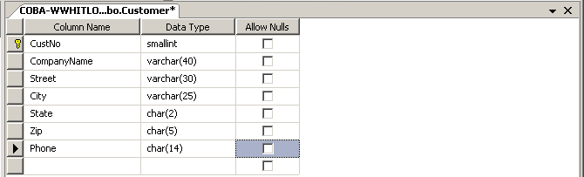
Adding Additional Table Columns
Continue to follow the Data Dictionary definition of this table by adding the Zip and Phone columns as shown below.
In the Dictionary, these two columns have Check constraints similar to that for the State column (refer to the printed Data Dictionary or see slide #12). Create these two constraints now.
As the process of creating these two Check constraints is similar to that already shown, no slides will be included here showing this.

Slide 31
Creating a Unique Index
The Data Dictionary listing for the Customer table also shows that the Phone column has the Unique property set for it.
When a column is designated as Unique, no two rows in the table may have the same value for the column. (This is similar to the Primary Key, and a Unique column is also called an Alternate Key.)
Similar to the way that a Primary Key is created with a specific type of index, a Unique column also is specified with a particular type of index.

Slide 32
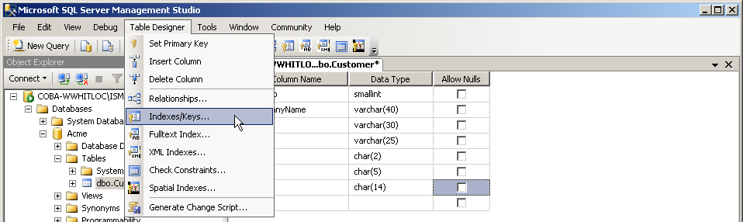
Creating a Unique Index
Again, the Indexes/Keys command is selected from the Table Designer menu item in the Menu Bar.

Slide 33
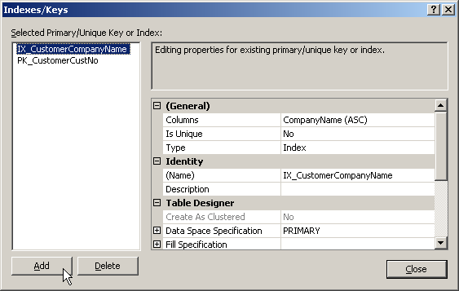
Creating a Unique Index
The Indexes/Keys dialog box appears. The names of the indexes created earlier appear in the white box on the left. Click the Add button to add a new index.

Slide 34
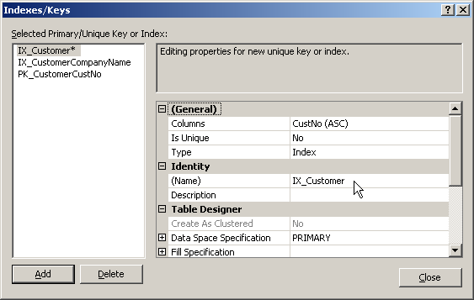
Creating a Unique Index
The Indexes/Keys dialog box appears with a new, generically-named (IX_Customer), index listed in the white box on the left side of the screen.

Slide 35
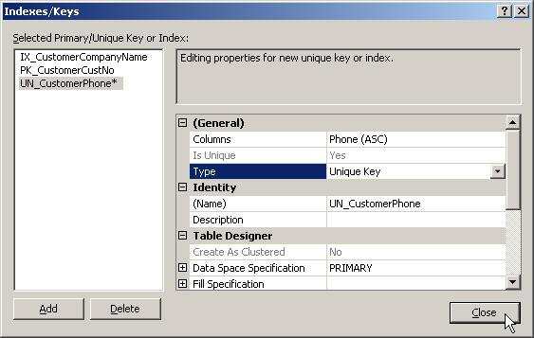
Creating a Unique Index
Make the following changes to the defaults:
  Name Property: UN_CustomerPhone
  Columns Property: Phone (ASC)
  Type Property: Unique Key
Click Close to continue.

Slide 36
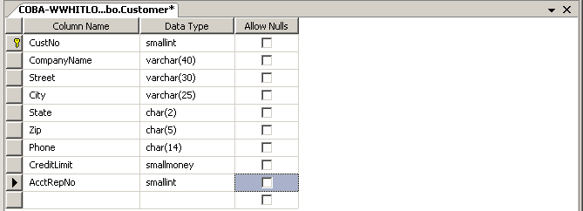
Adding Additional Table Columns
Add the CreditLimit and AcctRepNo columns as shown below.
As shown in the Data Dictionary, create a Check constraint for the CreditLimit column ([CreditLimit] >= (0) AND [CreditLimit] <= (10000)) and a regular index for the AcctRepNo column.
REMINDER: Periodically save your work by clicking on the Save tool in the Tool Bar.

Slide 37
A Note on Foreign Keys
The FK-PK relationships between tables are also defined in the Table Designer screen.
However, at the moment we only have one table created in our sample database and cannot yet create a relationship between tables.
Next, we will create a second table in our sample database and we will then examine how to create a FK-PK relationship between the tables.

Slide 38
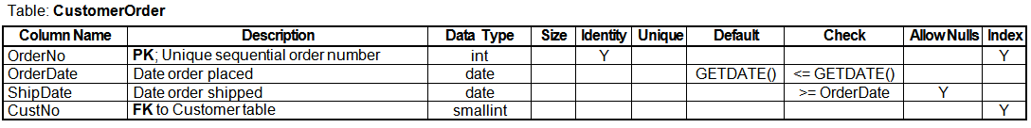
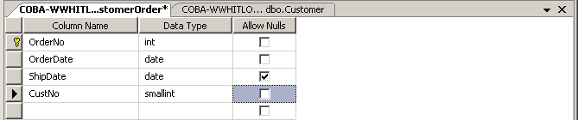
Creating the CustomerOrder Table
Follow the steps shown on the previous slides to create the CustomerOrder table defined with this entry from the database Data Dictionary:
The Table Designer view of this new table:
See the next slide for important notes on this table’s design.
Note that Null values are allowed here.

Slide 39
Creating the CustomerOrder Table
Set the OrderNo column as the table PK, and also as an Identity column (with Identity Seed value of 10000 and Identity Increment value of 1).
Set the Default property for the OrderDate column as GETDATE() (in the Default Value or Binding property area in the Column Properties grid below the Table Designer grid). (See next slide.)
Set both Check constraints:
  For OrderDate: OrderDate <= GETDATE()
  For ShipDate: ShipDate >= OrderDate
Add a regular index for the CustNo column.

Slide 40
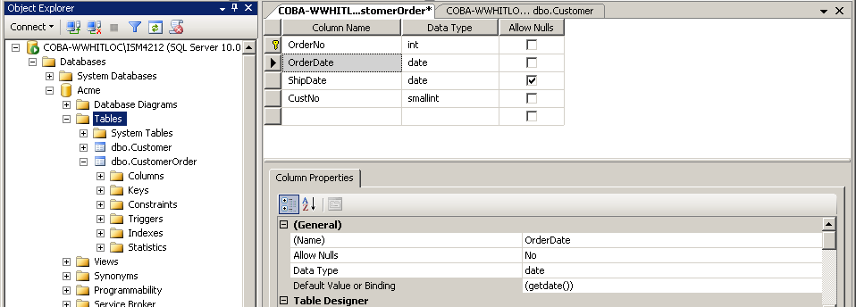
Setting a Default Value
Here, the OrderDate column has a Default value set for it in the Column Properties area.
(NOTE: During data entry, default values are entered into the table columns by SQL Server automatically after the entire data row is entered and the cursor moves to the next row.)
Select column here.
NOTE: If you save the table and then review this default later, you may find the display of the default value slightly changed. For example, the GETDATE() value entered here may be displayed as: (getdate())
NOTE: The default value entered does not include the column name as is done with Check constraints.
Enter default value here.

Slide 41
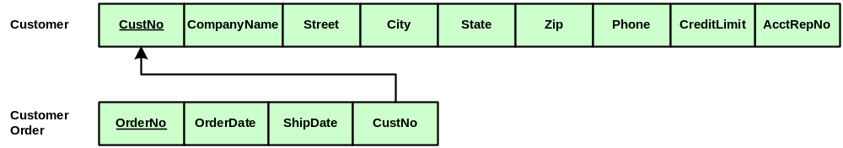
Creating a FK-PK Relationship
We now have two tables created in our sample database, and we are ready to create the rela-tionship between these tables illustrated in the following partial database relational schema.
As can be seen, the CustNo column in the CustomerOrder table is a Foreign Key refer- encing the Primary Key of the Customer table.

Slide 42
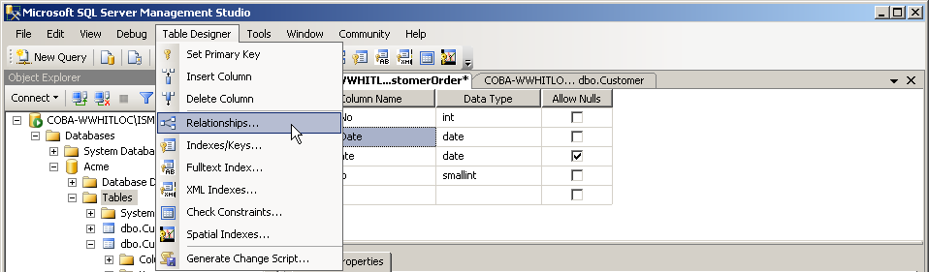
Creating a FK-PK Relationship
With the CustomerOrder table still open for design, select the Table Designer menu item in the Menu Bar, then select the Relationships item from the drop-down menu.
NOTE: If you have not already done so, save your completed CustomerOrder table before creating this relationship.

Slide 43
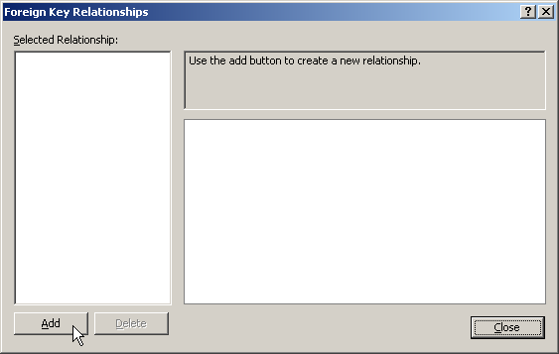
Creating a FK-PK Relationship
The Foreign Key Relationships dialog box appears. Any existing relationships for the cur-rent table (CustomerOrder) would appear here. Click the Add button to add a new relationship.

Slide 44
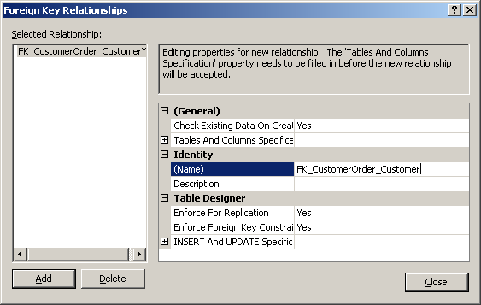
Creating a FK-PK Relationship
Recommended: Edit the Name property of the relationship, following the naming convention described below. This clearly identifies the two tables involved in the relationship.
A good naming convention to follow for FK-PK relationships is:
* Prefix of FK, followed by
* Underscore, followed by
* FK Table Name, followed by
* Underscore, followed by
* PK Table Name

Slide 45
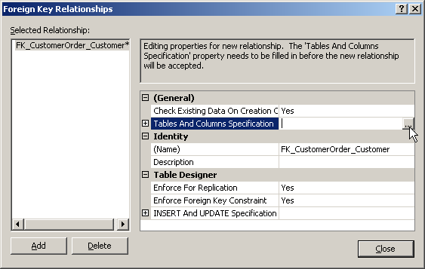
Creating a FK-PK Relationship
Next, click in the property row labeled Tables And Columns Specification, as shown below. A button labeled with 3 periods will appear to the right of this row. Click on this button.

Slide 46
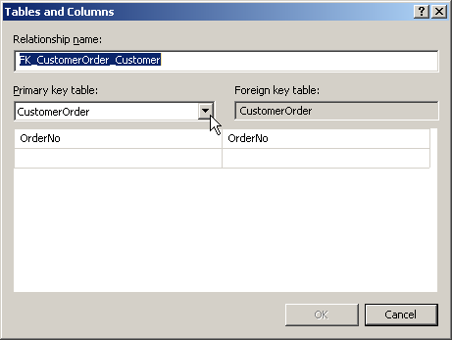
Creating a FK-PK Relationship
The Tables and Columns dialog box appears. In this box you will specify the FK column and table, and PK column and table, that specifies the current relationship being created.

Slide 47
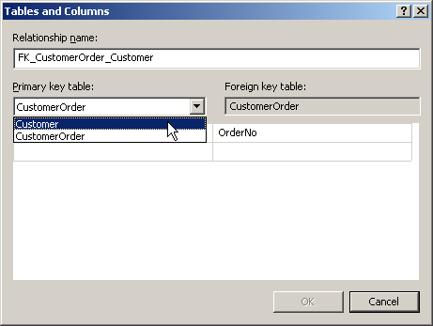
Creating a FK-PK Relationship
The table containing the PK column in the relationship must be specified in the Primary Key Table combo box on the left. Select the Customer table from the drop-down list.

Slide 48
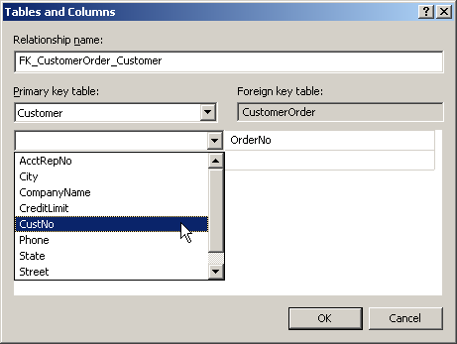
Creating a FK-PK Relationship
Next, click in the first row of the grid directly below the table name. Click the arrow box that appears to the right of the row to open a drop-down list of column names. Select CustNo.
This list contains all of the columns in the table, listed in alphabetical order.

Slide 49
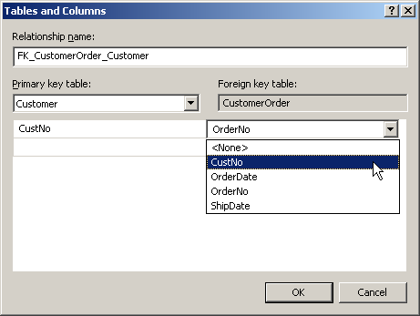
Creating a FK-PK Relationship
Follow the same procedure shown on the previous slide to select the CustNo column in the Foreign Key Table (CustomerOrder) side of the screen.

Slide 50
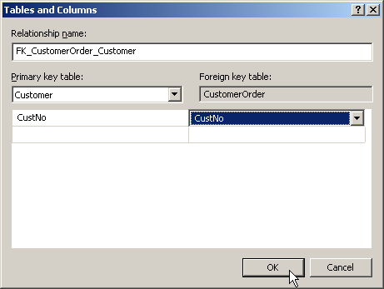
Creating a FK-PK Relationship
The FK-PK relationship has now been com- pletely defined. Click the OK button to close this dialog box and return to the Foreign Key Relationships dialog box.

Slide 51
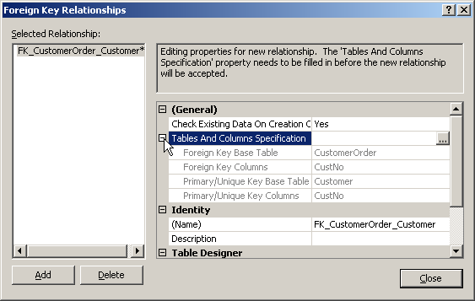
Creating a FK-PK Relationship
Click the icon to the left of the Tables And Columns Specification property name, and verify the correctness of the data displayed. Click the Close button to finish the procedure.

Slide 52


Creating a Database Diagram
Relationships between tables can be viewed graphically, in a type of relational schema.
Double-click on the Database Diagrams object name in the Object Explorer pane.
A message box displays. Click the Yes button.

Slide 53
Creating a Database Diagram
NOTE: The following error message may display when attempting to create a SQL Server Database Diagram:
“Database diagram support objects cannot be installed because this database does not have a valid owner. To continue, first use the Files page of the Database Properties dialog box or the ALTER AUTHORIZATION statement to set the database owner to a valid login, then add the database diagram support objects.”
This occurs when a database created under one user login account is modified using a different login account. Solution:
* Right-click on the name of your database in the Object Explorer pane.
* From the pop-up menu, select Properties.
* In the Database Properties dialog box, click on the Files item on the box’s left side.
* On the top right side of the box, click the "..." button to the right of the Owner field.
* In the Select Database Owner dialog box that appears, click the Browse button.
* In the Browse for Objects dialog box that appears, click the check box to the left of the [NT AUTHORITY\SYSTEM] item, then click the OK button.
* Click OK buttons as needed to close the remaining open dialog boxes.

Slide 54

Creating a Database Diagram
Next, right-click on the Database Diagrams object name in the Object Explorer pane, and then click on the New Database Diagram command. This opens a blank diagram area and the Add Table dialog box (see next slide).

Slide 55

Creating a Database Diagram
With this dialog box, you add the tables you desire to include in the diagram. Click the Add button for each table listed, then click Close.
This picture shows how the screen looks after the Customer table has been added to the diagram, just before also adding the CustomerOrder table.

Slide 56

Creating a Database Diagram
The new diagram includes both tables and the relationship line connecting the tables.
The relationship line connecting the tables displays a key symbol at the end of the line connecting to the PK table and an infinity symbol at the end of the line connecting to the FK table.

Slide 57


Creating a Database Diagram
The diagram can be edited by clicking and dragging the tables and the relationship line.
Here, the appearance of the diagram has been improved by making several such edits.
Experiment with your diagram until you have formatted it to look like the diagram shown here.

Slide 58


Creating a Database Diagram
Click the Save button in the Tool Bar. The Choose Name dialog box will appear. Type the desired name for the diagram and click OK.
(Your Tool Bar locations may vary from that shown here.).

Slide 59

Creating a Database Diagram
A dialog box like that shown below may appear at this time. If such a dialog box appears, simply click the Yes button to close it.

Slide 60

Creating a Database Diagram
The database diagram may be printed by selecting the Print command in the File menu in the Menu Bar.
NOTE: A better quality printed diagram may be obtained by doing a screen capture, pasting it into Microsoft Word, editing as necessary, and then printing from there.
(This procedure is beyond the scope of this presentation.)

Slide 61

Closing Object Windows
Before continuing, close the open windows for the database diagram and both table designs.
This is done by clicking on the close icon ( x ) on the right-hand side of the object tabs as shown below.

Slide 62

Adding Data to Tables
We will next add some data to our two tables.
Begin by clicking the + sign icon to the left of the Tables object name in the Acme database.

Slide 63

Adding Data to Tables
To add data to the Customer table, right-click on the table name and, from the pop-up menu, click on the Edit Top 200 Rows command.
Note: If you wished to edit the structure of an existing table, rather than add data to it, you would select the Design command here. (The Design command is named Modify in some older versions of SQL Server.)

Slide 64

Adding Data to Tables
The data entry grid for the Customer table appears. This is similar to a spreadsheet in appearance, and is where you enter data.
The word NULL appears in each column of the first row because no data has yet been entered.
Not all of the columns in the table are visible in this screen view. A horizontal scroll bar at the bottom of the data entry grid can be used to scroll to the right to see the remaining table columns.

Slide 65

Adding Data to Tables
Below, the first row of data for the Customer table is in the process of being entered.
The CustNo column is an Identity column and its value is entered automatically by SQL Server, not by the data entry person.
The small red circles displaying exclamation points are reminders that the data for this row has changed since the table was last saved. Moving the focus (insertion point cursor) to another row causes the data to be automatically saved.

Slide 66

Adding Data to Tables
The widths of columns can be adjusted manu-ally by placing the mouse cursor on the line dividing the column headings (resulting in a two-headed arrow as shown below), then clicking and dragging to the desired width.
Note: A useful shortcut to modifying column widths is to double-click the mouse when the two-headed black arrow appears. This will widen the column just enough to display all data entered into the column.

Slide 67

Data Validation
Check constraints, such as those created ear-lier for this table, should automatically verify that the data entered into the table meets specific conditions or formats.
What happens when data violate a constraint?
Here, phone data is being entered (in the 3rd row) using an incorrect format (the space is missing). When the row (not the column) is completed, the Check constraint for this column will catch this error and report it.

Slide 68


Data Validation
The violated Check constraint causes the error message shown below to display.
The text of the error message identifies which constraint was violated by the data being entered in the current row.

Slide 69

Skipped Identity Values
The screen below shows the result of correct-ing the error described on the previous slide and successfully completing the third row.
Note that the CustNo value assigned to this row has skipped a value (is 103, instead of 102).

Slide 70
Skipped Identity Values
The failed initial attempt to save the third row, when the Check constraint rejected the original phone number value, caused the CustNo value assigned by the Identity property to increment even though the row was rejected.
When the phone number was corrected and the row was successfully saved, the Identity property again incremented the CustNo value.
This is what caused the “gap” in the sequence of values for the CustNo column. (See next slide for a way to remove the gap, if desired.)

Slide 71
Skipped Identity Values
The automatic values for an Identity column (e.g., CustNo) can be manually edited, if desired.
To do so, you must:
  Edit the table design to temporarily change the Identity property for the affected column to “No”.
  Save the table.
  Make the desired data changes to the column.
  Change the Identity property back to “Yes” (resetting, if necessary, the Seed and Increment properties to their previous values – see slide 14).
  Save the table again.

Slide 72
More Data Validation
Column data validation provided by a Check constraint was demonstrated earlier.
Column data validation is also available by:
  Specifying a column as a Primary Key.
    no duplicate values allowed in the column
  Creating a Unique index on a column.
    no duplicate values allowed in the column
  Not checking the Allow Nulls box for a column
    no null values allowed in the column.
  Creating a relationship (referential integrity).
    FK values must have matching PK values

Slide 73

More Data Validation
The data validation methods listed on the previous slide will guard against data entry errors in much the same way as shown for the Check constraint on slide 68.
Error messages will display whenever an attempt is made to enter data that violates one of these data validation rules, such as this:

Slide 74
Copying a Database
If you wish to copy a database from one computer to another, it is necessary to:
  Locate the two files that make up the database (the .mdf and .ldf files) on the source PC.
  Detach the database from the source PC’s instance of SQL Server (you cannot copy the database files if the database is still attached).
  Use Windows Explorer or My Computer to copy the .mdf and .ldf files to the destination PC.
  Attach the database to the destination PC’s instance of SQL Server.

Slide 75
Summary
In this presentation, the following SQL Server database procedures have been described:
  Creating a database and creating database tables.
  Creating an Identity column.
  Creating a Primary Key.
  Creating a Regular index and a Unique index.
  Creating a Check constraint.
  Creating a Default value.
  Creating a PK-FK relationship between tables.
  Creating a Database Diagram.
  Adding data to a database table.
  Copying a database from one PC to another.

Slide 76
Done

